Slide 1

Theoretical Research on Quantum Storage Using Solid State Drives (SSD’s)
QUANTUM-LEAPERS
Date : 11/28/2023
Delivered by:
Bhavesh Naidu Kulluru
Sai Dheeraj Ravipati

Slide 2

INTRODUCTION
1
SSD’s
3
Q-bits
What are ssd - how are they different from hdd
How do they work
What are Q bits
how are they different from conventional bits
how do we store them?
2
Quantum Tunneling
4
Quantum Superposition
What is Quantum tunneling
how is this principle used in ssd’s
Understanding quantum superposition
how this principle is involved in fundamentals of quantum computing
5
OUR IDEA
Integration of SSD’s with Q-bit storage mechanism’s with special modified architecture

Slide 3


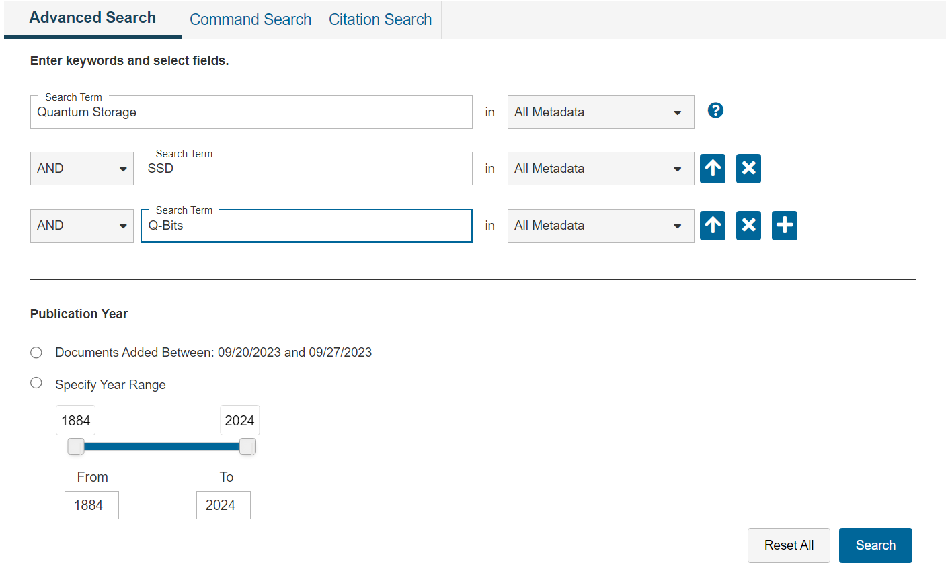
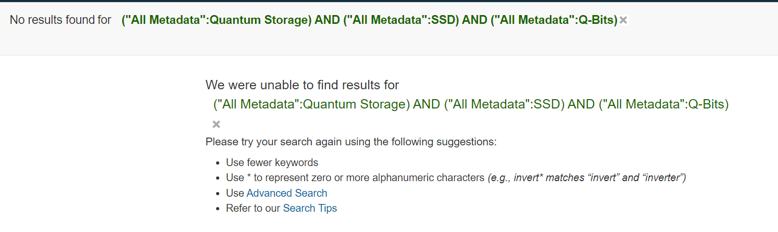
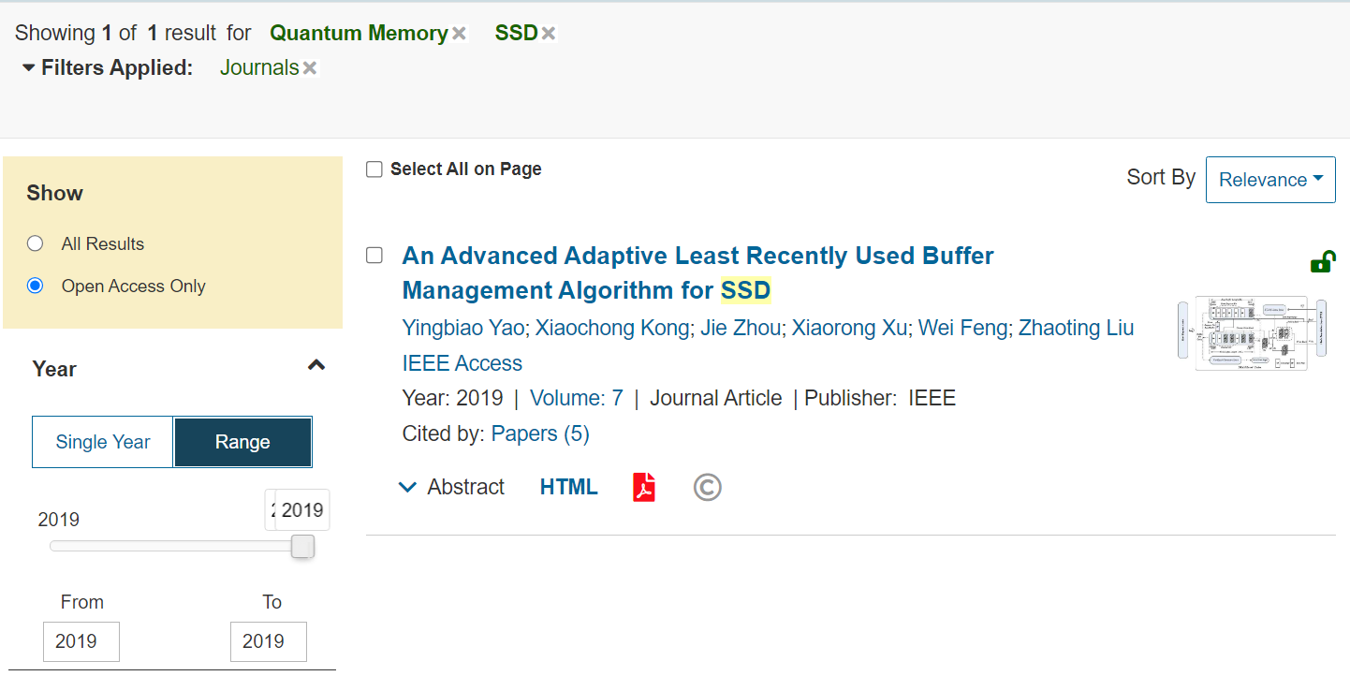
LITERATURE REVIEW
Based on our Research of this topic on IEEE
1
Challenges in Storing Qubits
Decoherence
Error Correction
3
there is a noticeable lack of research on the use of SSDs for storing qubits
2
4
A brief literature survey on IEEE from the 1880s to 2023 yielded only one result that covered both SSDs and qubits.

Slide 4
DEEP DIVE ANALYSIS
Quantum Mechanics
V-NAND
CHARGE-TRAP Flash memory
Q-Bits
Quantum-Superposition
Quantum tunneling
The double-slit experiment
CTF
Integration of SSDs and Qubits

Slide 5
CONCLUSION
Our research explores a new idea: using Solid State Drives (SSDs) to store quantum bits or qubits. This is a unique approach in the world of quantum computing.
01
Our research contributes to this growing field, suggesting that if we can make this integration work, it might lead to powerful quantum computers solving problems that regular computers can't..
Our suggested method involves a special part in the SSD designed just for qubits. This design aims to tackle the specific challenges qubits pose during storage.
03
02

Slide 6
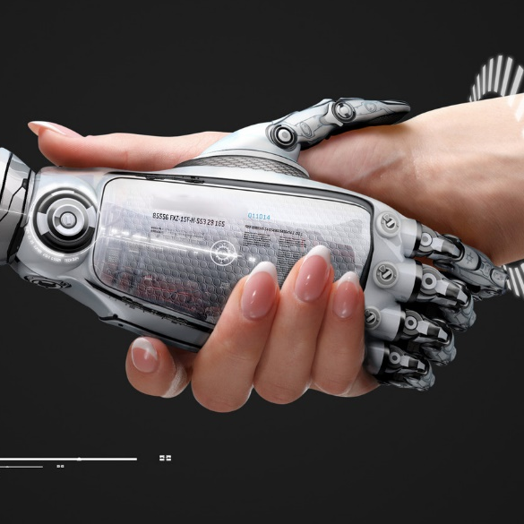
REFERENCES
we would like to extend our thanks to
ALL THE SCIENTISTS WHO CONTRIBUTED THEIR WORK IN THE FIELD OF QUANTUM PHYSICS
GOOGLE SEARCH ENGINE
YOUTUBE
WIKIPEDIA
SEVERAL WEBSITES ON THE INTERNET

Slide 7
YOU
THANK
Quantum-Leapers

